Slide 1

Multiple disease screening to destigmatize HIV testing and increase identification of Persons Living with HIV in Kisumu, Kenya
Kelvin Ndede¹, Doris Naitore¹, Christopher Ouma¹, Fillet Lugalia¹, Cassia Wells¹, Brenda Senyana¹, Juliana Otieno², Ruby Fayorsey¹, Mark Hawken¹, and Elaine Abrams¹
Affiliations:
¹ICAP at Columbia University,
²Jaramogi Oginga Odinga Teaching and Referral Hospital, Kisumu, Kenya

Slide 2





Presentation Outline
Kenya HIV country context
Progress towards first 90 target in Kenya
ICAP innovation for reaching men
Results of innovation
Conclusion, recommendations and next steps

Slide 3
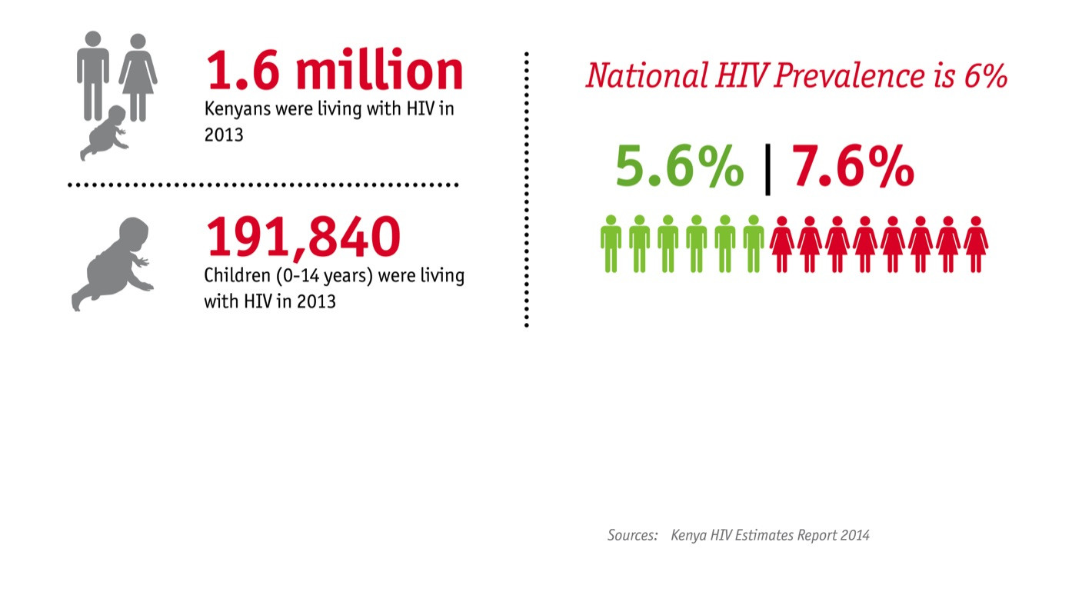
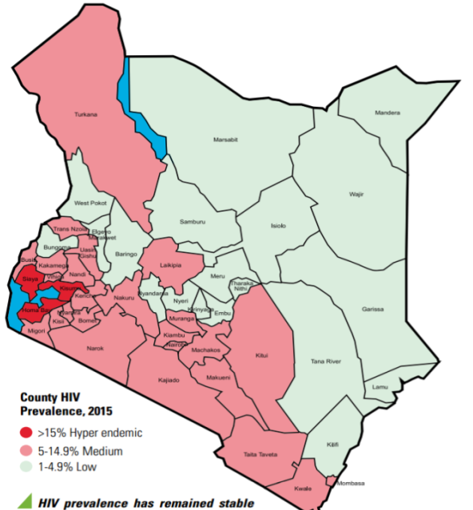
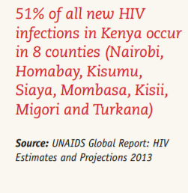
Kenya Country Context
Kenya has the 4th largest HIV epidemic in the world: national HIV prevalence is ~6% and there are 1.5 million PLHIV
ICAP supports the Teaching and Referral Hospital in Kisumu to provide HIV prevention and treatment services
Kisumu County is located in western Kenya has an HIV prevalence of 19%- 3rd highest in the country
Notes:
SEE EDITS

Slide 4
Kenya is not on course to reach the UNAIDS first 90 target for men
Females Males
89%
89%
84%
84%
84%
67%
84%
84%
84%
84%
67%
84%
84%
Women have almost reached 90% target for knowledge of HIV status but there is gap for men: 67% overall know HIV status (only 48% among young men)
Source: COP 2017 Approval Meeting Outbrief, April 21, 2017

Slide 5
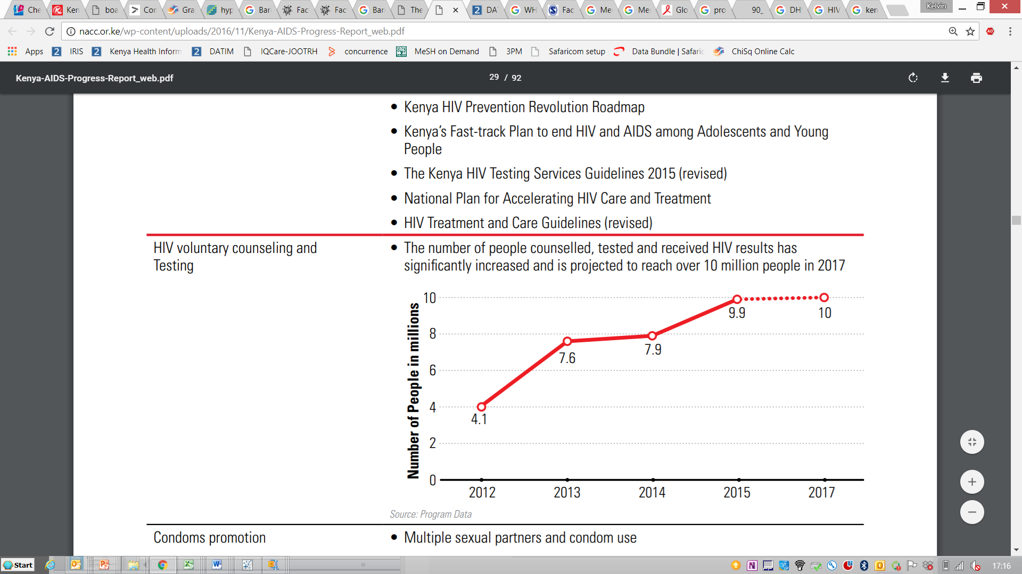
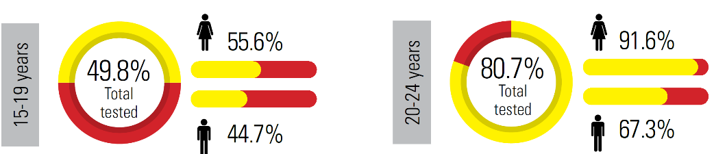
Scale-up of HIV testing services in Kenya
Men
Rapid Scale-up of HIV testing and Counselling services, Kenya
Approximately 30% of men in Kenya have never tested for HIV
HIV Testing coverage in Kenya 2007 vs. 2012 by gender
Proportion of young people in Kenya ever tested for HIV by age and gender
Source: Kenya AIDS Indicator Survey Report, 2012

Slide 6
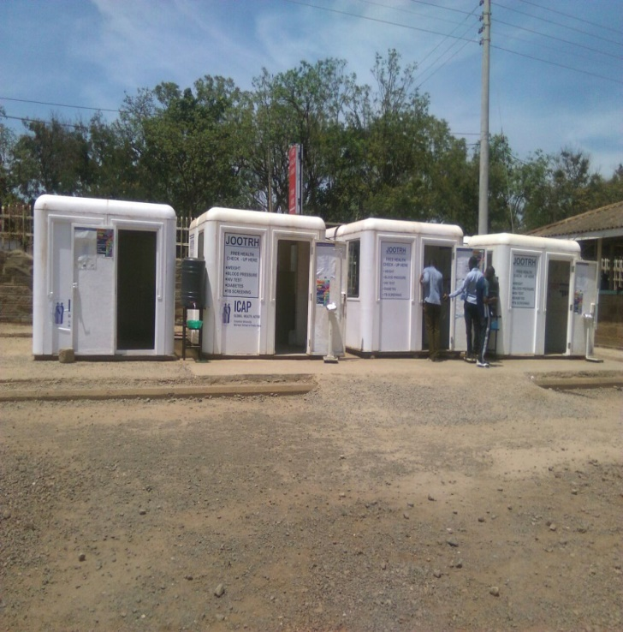
ICAP innovation for reaching men
In March 2017, a multiple disease screening program started offering wellness services including screening for:
  TB disease
  Hypertension (blood pressure)
  Nutritional status (weight, height)
  HIV infection
Located at the hospital entrance, clients and visitors (>15 years old) were eligible to access the service from 8 am to 9 pm daily including weekends
Multiple disease screening booths at the hospital main entrance

Slide 7
Implementation of multiple disease screening service
HCWs trained on the multiple disease screening using national guidelines
Developed and adopted M&E tools, job aids, SOPs that addresses TB, hypertension and nutrition
Awareness creation through fliers, posters and banners
Established referral tracking system between the multiple disease screening service and other points of service within and outside the hospital
Deployed HTS counselors to deliver HTS and multiple disease screening
Notes:
See slight edit to title
KN: Noted

Slide 8
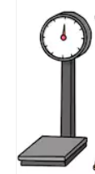
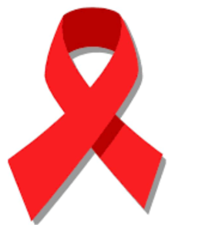
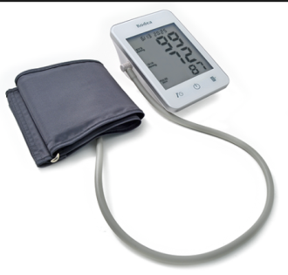
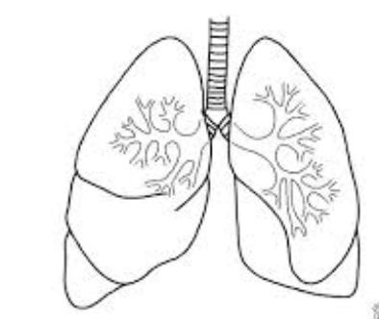
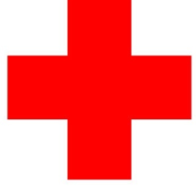

Package of Service at the Multiple Disease Screening Service
Nutritional
assessment
HIV testing
and linkage to ART
Blood pressure
assessment
TB screening
Referrals
Notes:
scale

Slide 9
Results of implementation

Slide 10
HIV testing cascade at the multiple disease screening service, April-December 2017
95%
100%
---------------------------
Data Source: HTS Registers, Linkage Registers, Health Check Registers
Notes:
Changed colors here b/c you were using the female/male colors and needed to differentiate so people aren’t confused

Slide 11
Age and gender of clients tested at the multiple disease screening service April-December 2017 (n=5,919)
Gender
Age group by gender
---------------------------
Data Source: MoH 362 Register
Notes:
In previous slide you listed period as April to December but here it’s July to December, which is correct?? NEED TO CHECK ALL and make sure consistent

Slide 12
Proportion of men tested at the multiple disease screening service compared to other points of service
Gender
Age group for males
---------------------------
Data Source: MoH HTS Registers April-December 2017
Notes:
Kelvin – I’m actually still under on what the figure on right shows, is it the proportion of everyone tested at different service points who were male by age group? So you would say – among older clients, a higher proportion of men were tested at MDS compared to women and as compared to other service points?

Slide 13
HIV testing positivity yield among all tested at multiple disease screening service compared to other points of service
---------------------------
Data Source: HTS Registers, Linkage Registers, Health Check Registers April-December 2017
Notes:
Assume this is all tested not just men? If only men, need to say. If there were differences in positivity by sex, would include, if you send me data, I can make a quick figure

Slide 14
Proportion of men accessing services at the multiple disease screening service
(n=5,919)
Weekdays
Evenings
Weekends
Timing | Eligible | Tested | Men Tested | Positive | Linked
Weekdays | 3806 | 3806 | 2002 (53%) | 94 (2.5%) | 52 (55%)
Weekend | 858 | 858 | 446 (52%) | 4 (0.5% | 3 (75%)
Evening | 1255 | 1255 | 717 (57%) | 14 (1.1% | 11 (79%)
Notes:
Remember to note for audience that scale is different for numbers of clients tested

Slide 15
Multiple disease screening outcomes
BMI
Blood pressure
---------------------------
Data Source: Health Check Registers April- December 2017

Slide 16
Conclusion

Slide 17
Conclusions and Recommendations
Providing HIV testing and counseling within a multiple disease screening service is an innovative approach to reach men who do not routinely access health services
The extended hours on weekends and evenings were utilized more by men than women
HIV positive yield among those tested was similar in multiple disease screening service as compared to inpatient and inpatient wards
This approach also identified clients who had high or low BMI, hypertension or presumptive TB

Slide 18
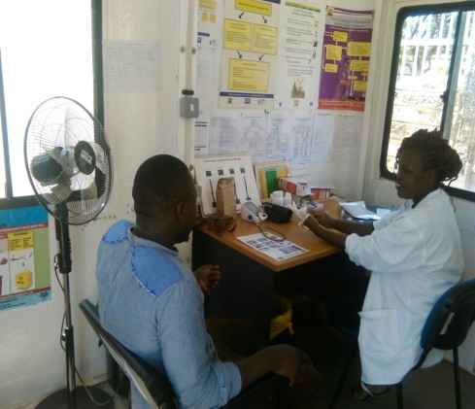

Acknowledgement
Ministry of Health

